Slide 1
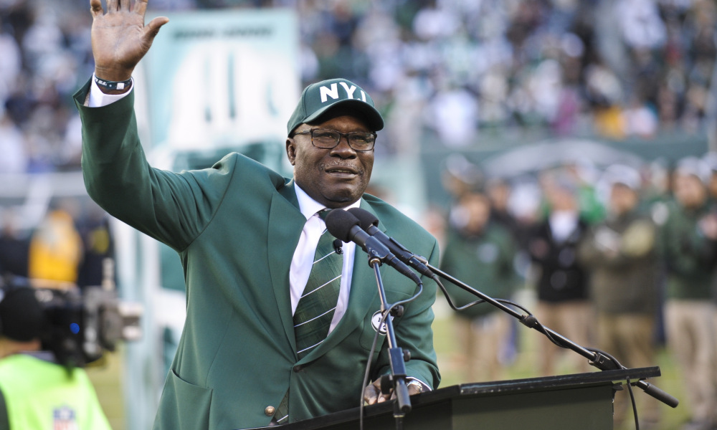

Sport Data Analysis on Emerson Boozer
Emmanuel Isidahomen
Dr.Urban Wiggins

Slide 2

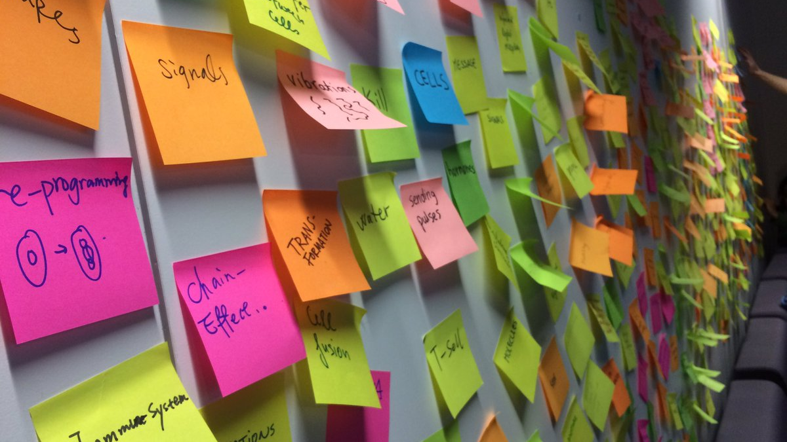



Rationale and Introduction

Slide 3

Morgan State basketball Legend Marvin Webster Inducted to the National Collegiate Basketball Hall of Fame
https://www.espn.com/video/clip/_/id/25290910

Slide 4
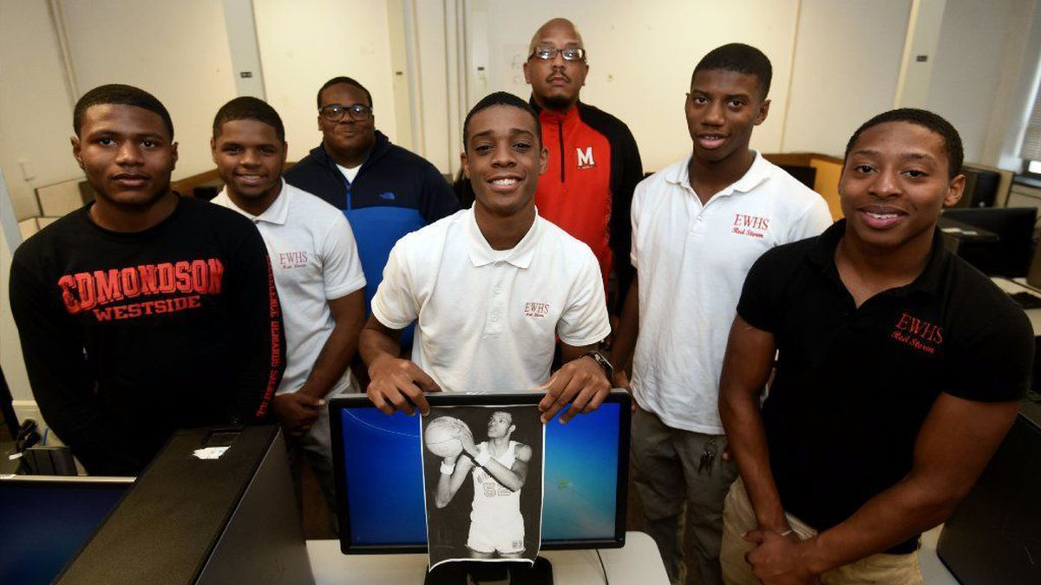
A group of bright students in the football team from Edmondson-westside high school from Baltimore created a sports analytics club to take on a project on Marvin Webster. Webster was a former Edmondson student. Their goal was to gather a bunch of numbers and research on Marvin Webster game data stats and compare them to the other collegiate basketball players at that timeline he start playing football at the NBA. Their hard work and dedication helped the former Morgen State basketball player Marvin Webster known as “the human eraser” get inducted into the National Collegiate Basketball Hall of Fame.
Therefore, a group of students from Wicomico high school and I decided to conduct the same research method on Emerson Boozer Jr and help save his memories that he left at the university and induct him to the NFL hall of fame in the future.

Slide 5
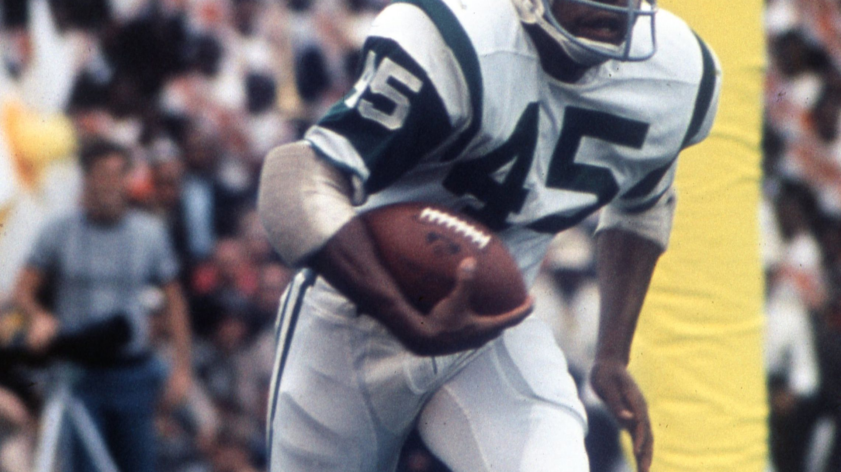
Who is Emerson Boozer ?

Slide 6

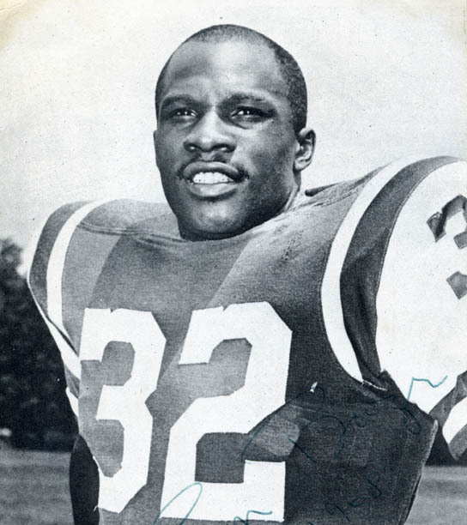

Emerson Boozer was born in Augusta, Georgia on the fourth of July in 1943 where he attended Laney high school. During his time in college, he started playing football for the Maryland State College as a running back. Emerson graduated from Maryland State College in 1966 with a degree in Industrial Arts Education. He got drafted to the New York jets in 1965 within his third season he played in the super bowl where he helped his team beat the Baltimore colt.

Slide 7
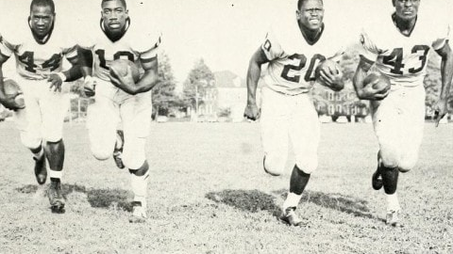
Appearances on Leaderboards, Awards, and Honors

Slide 8
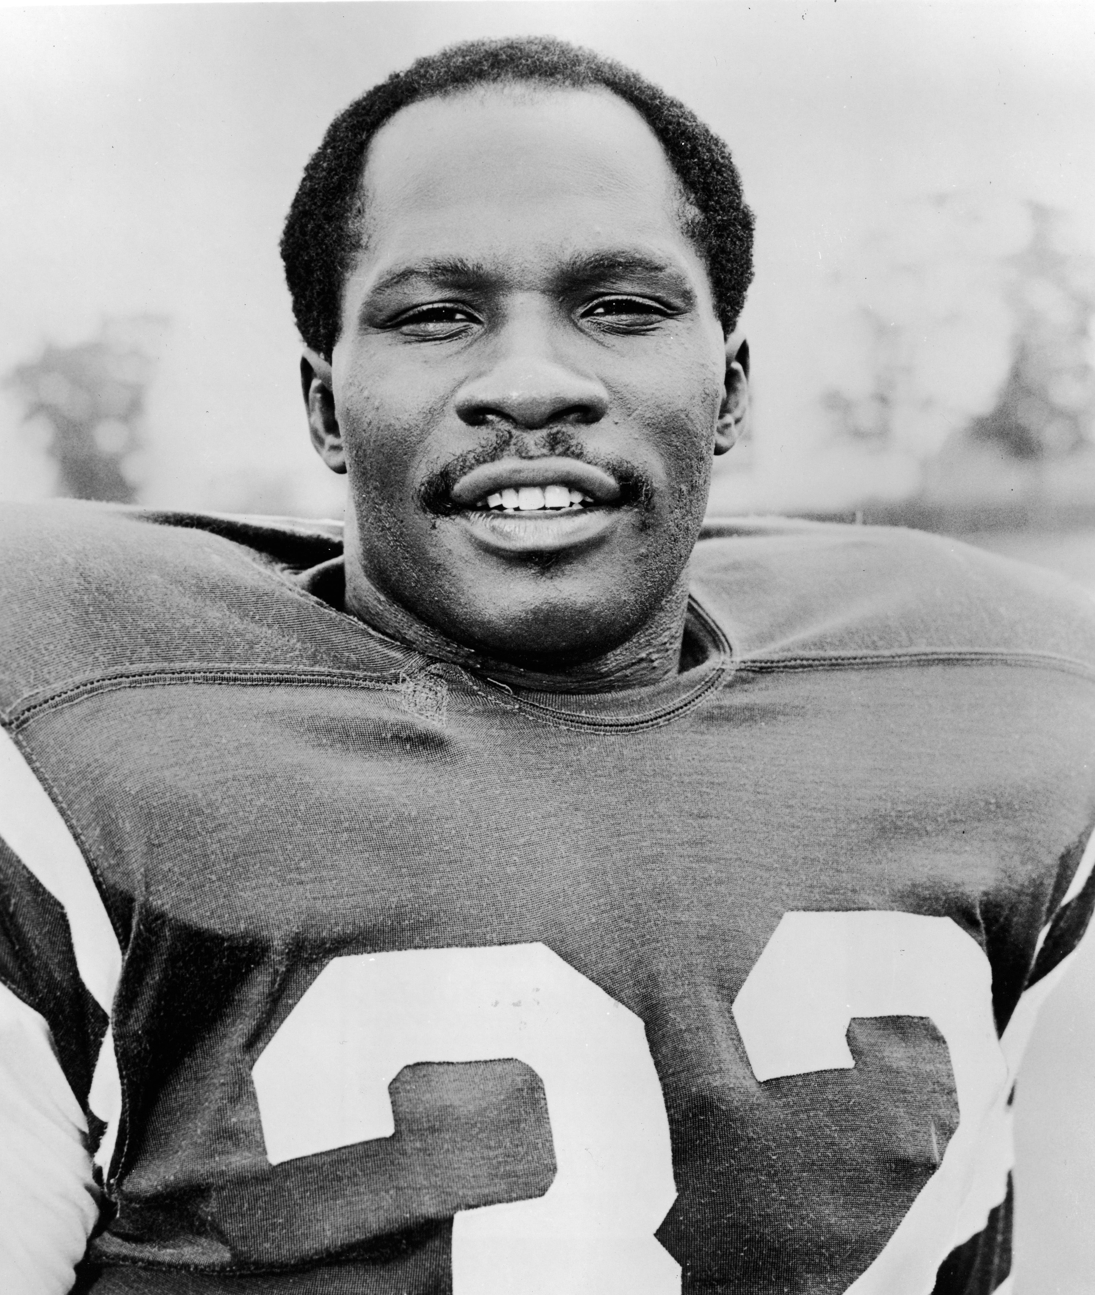
References and Website Design for Roger Brown
https://www.analyticsinsight.net/how-analytics-is-making-teams-win-in-sports/#targetText=Sports%20Analytics%20includes%20the%20use,it%20to%20make%20informed%20decisions.
https://www.umes.edu/uploadedFiles/_WEBSITES/Football/Content/emerson%20boozer.pdf
https://www.pro-football-reference.com/players/B/BoozEm00.htm

